Slide 1
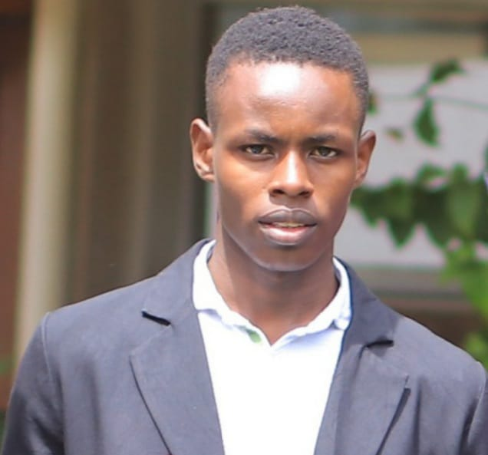
My Autobiography
I’m John Denge, and I’m thrilled to share my life story with you. It’s a journey filled with ups and downs, lessons learned, and unforgettable moments.
John Denge

Slide 2
My Early Life in Kisumu, Kenya
I was born into a loving family in the town of Kisumu, Kenya. My parents, Everlyn and Musa Robert Ouma, have always been my pillars of support.
Kisumu
Childhood Memories
Kisumu is a vibrant city on the shores of Lake Victoria, known for its beautiful scenery and rich cultural heritage.
My childhood in Kisumu was filled with laughter, exploration, and the warmth of community. The city's charm and my family's love left an indelible mark on my heart.

Slide 3

Growing Up in a Family of Six
As the second born in a family of six—three boys and one girl—my childhood was a whirlwind of sibling rivalry, shared laughter, and unwavering support.
Sibling Bonds
Family Values
Shared Memories
Growing up with siblings has taught me the importance of teamwork, compromise, and unconditional love.
My parents instilled in us strong values, including respect, integrity, and the pursuit of knowledge.
We created countless memories together, from playing games to sharing stories, each one a precious thread woven into the fabric of our family.

Slide 4

Challenges and Triumphs
Life wasn't always easy. We faced challenges, from financial struggles to the uncertainties of growing up in a developing country. However, we learned to adapt, overcome, and appreciate the little things.
1
Financial Hardships
We learned to be resourceful and find creative solutions to overcome financial challenges.
2
Educational Struggles
Access to quality education was a challenge, but we persevered, valuing the importance of knowledge.
3
Resilience
Through these challenges, we learned resilience, adaptability, and the power of determination.

Slide 5
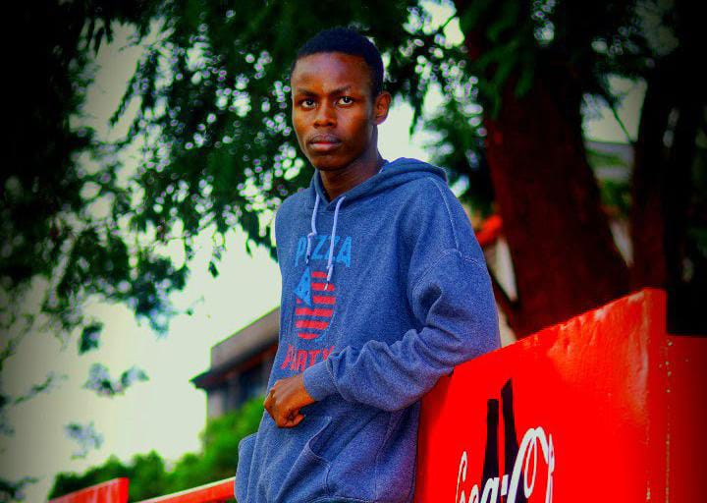
Pursuing My Education
Education was always a priority in our family. We understood the value of knowledge and its potential to shape our future.
1
Primary School
2
Secondary School
My early education instilled a love for learning and sparked my curiosity about the world.
I excelled in academics, particularly in [SPECIFIC SUBJECT], which fueled my passion for [FIELD].
3
University
I pursued higher education, earning a degree in [FIELD], laying the foundation for my future career.

Slide 6
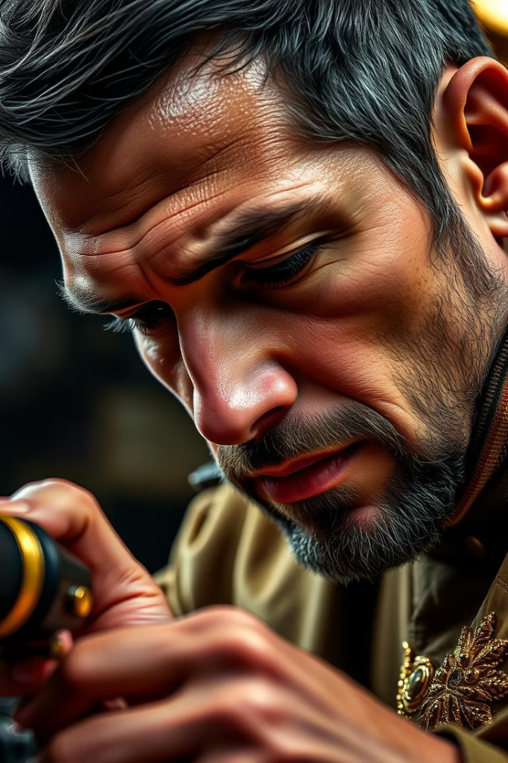



Discovering My Passion for [FIELD]
My interest in [FIELD] began early on, sparked by [SPECIFIC EVENT OR INFLUENCE]. I was drawn to its [POSITIVE ASPECTS OF FIELD] and the opportunities it offered.
Inspiration
I found inspiration in [SPECIFIC PEOPLE OR EVENTS] within the field.
Passion
My passion for [FIELD] grew as I explored its depths and discovered its impact on the world.
Drive
The drive to contribute to this field fueled my determination to pursue a career in it.

Slide 7

Milestones and Achievements
My journey in [FIELD] has been filled with milestones and achievements that have shaped my career. I've had the privilege of working on [SPECIFIC PROJECTS OR ACCOMPLISHMENTS], contributing to [POSITIVE IMPACTS OF WORK].
Year
Milestone
Achievement
[YEAR]
[MILESTONE]
[ACHIEVEMENT]
[YEAR]
[MILESTONE]
[ACHIEVEMENT]
[YEAR]
[MILESTONE]
[ACHIEVEMENT]

Slide 8
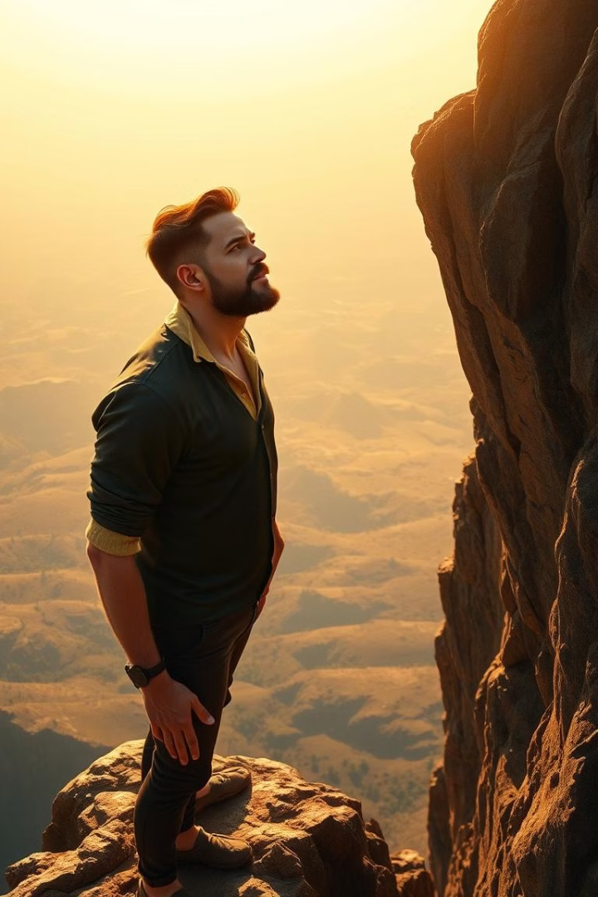



Looking to the Future
As I look to the future, I’m excited about the opportunities that lie ahead. I remain passionate about [FIELD] and committed to making a positive contribution.
Continuing Education
I plan to pursue further education and training to stay at the forefront of [FIELD].
Innovation and Growth
I'm dedicated to pushing boundaries, innovating, and contributing to the advancement of [FIELD].
Impact
I hope to make a meaningful impact on the world through my work in [FIELD].

